Slide 1
Web Site Building with CSS
By Saygin Guven
Introduction

Slide 2
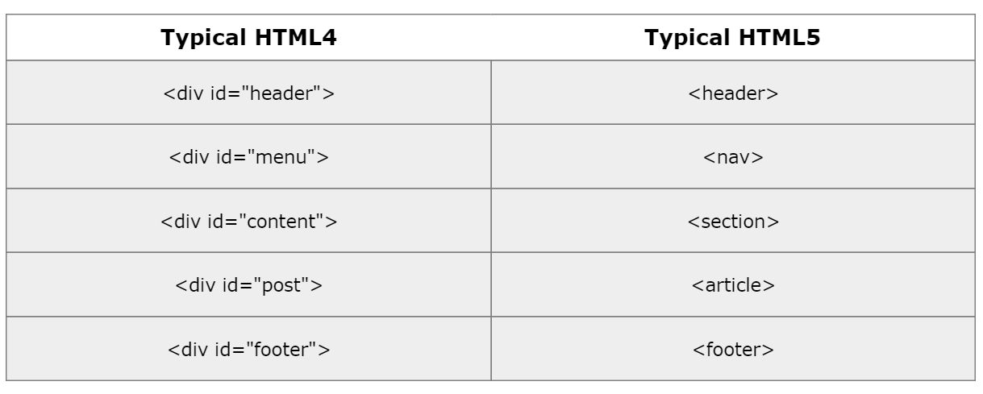
HTML4 vs HTML5

Slide 3
Selectors
Tag Characters
p {color:red;}
Class and ID selectors
#forId{}
.forClass{}

Slide 4
Selectors
input{
margin:4px;
}
[type]{
border: 1px solid red;
}
[type="text"]{
border: 1px solid green;
}

Slide 5
Descendant selectors
<div class="grandpa">
<div class=“parent">
<div class="child">
</div>
<div class=“child">
</div>
</div>
</div>
.parent. child{
}
.grandpa .child{
}

Slide 6
Select A tag
<div id="sectionA">
<div class="test">
<p><a href=""></a></p>
</div>
</div>
#sectionA .test p a{}
p a{}
#sectionA a{}

Slide 7
Child > selection
<div class="grandpa">
<div class=“parent">
<div class="child">
</div>
<div class=“child">
</div>
<div class=“descendant”> </div>
</div>
</div>
only child
grandpa child
grandpa>child

Slide 8
+ and ~ selectors
+ → adjacent tag
~ → following any sibling
, → is for grouping the selectors

Slide 9
Multiple class selection
.class1.class2 {
…
}
It will work as long as you have the both classes in the tag(s)

Slide 10
Pseudo-class selectors
a{
color:black;
}
a:hover{
text-decoration: none;
}
a:link{}
a:visited{}
a:active{}

Slide 11
First and last child
tag:first-child
tag:last-child
tag:first-of-type
tag:last-of-type
<article>
<!-- <h1></h1> -->
<p>hello</p>
<p>selectors</p>
<p>I am </p>
<p>paragraph</p>
<!-- <a href=""></a> -->
</article>

Slide 12
Nth child
:nth-child(index)
index = odd | 2 | 2n+1 | 4n+1
odd – 1,3,5, …
even – 2,4,6, …
:nth-of-type(index)
index = odd | 2 | 2n+1

Slide 13
example
<div class="wrapper">
<div class="box">1</div>
<div class="box">2</div>
<div class="box">3</div>
<div class="box">4</div>
<div class="box">5</div>
<div class="box">6</div>
<div class="box">7</div>
<div class="box">8</div>
<div class="box">9</div>
</div>
.wrapper{
overflow: hidden;
}
.box{
width: 20px;
height: 20px;
border: 1px solid red;
float: left;
padding:20px;
}
.box:nth-child(odd){
background: tomato;
}

Slide 14
:before, :after
Use it always with content : “string”
p:before{
content: "'";
}
p:after{
content: "'";
}
Content can be Unicode
U+1234

Slide 15
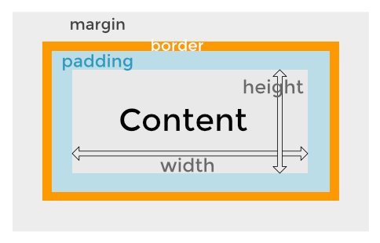
Mac Book Pro

Slide 16
Width and height
Inline elements require the display property
span{
width: 100px;
height: 100px;
display: block;
display: inline-block
}
div{
width: 100px;
height: 100px;
}

Slide 17
Width and height
<div>
<p>this is demo inside the div</p>
</div>
<p> hello this is <span> span </span> tag </p>

Slide 18
margin
margin accepts negative values
align center block elements
div {width:200px;
margin: 0 auto;}

Slide 19
Margin – accepts negative values
margin: 2px
margin: 2px 10px;
margin: 2px 10px 5px;
margin: 2px 10px 5px 2px;
margin:
margin: top | right | bottom | left

Slide 20
Padding – only positive values
padding: 2px
padding: 2px 10px;
padding: 2px 10px 5px;
padding: 2px 10px 5px 2px;
padding-index:
index: top | right | bottom | left

Slide 21
Border
border-width: 2px;
border-style: solid; (required)
border-color: red;
Shorthand
border: 2px solid red

Slide 22
Border-sizing
Border-box
Content-box
https://www.w3schools.com/cssref/tryit.asp?filename=trycss3_box-sizing
html { -webkit-box-sizing: border-box; -moz-box-sizing: border-box; box-sizing: border-box; } *, *:before, *:after { -webkit-box-sizing: inherit; -moz-box-sizing: inherit; box-sizing: inherit; }

Slide 23
Text for a tag
Text-decoration: none;
Text-transform: uppercase;
Font-weight: 700;

Slide 24
Inline and float
inline-block has extra space in HTML5 structure
width: 25%;
display: inline-block;
-- this will work without HTML spaces
Float behaves different
you need to add
overflow:hidden;
text-align: center;
width:25%;

Slide 25

From the ITD Canada team!!!

